Slide 1



A World of Total Rewards
Welcome to your 2025 Part Time Benefit Enrollment!
Notes:
Welcome to your New Hire benefits enrollment for Kimball Electronics. Our Benefits are a key part of your Total Rewards Package at Kimball Electronics.

Slide 2

Where to find the online New Hire Benefit Guide
Sign into Workday
Click on your picture in the right-hand corner of the screen
Click on Drive
Click on Employee Information
Click on Benefits – US Only
Find 2025 New Hire Guide
Notes:
If you have not received a hard copy of the 2025 Benefits Guide, it can also be found in Workday.
Sign into Workday
Click on your picture in the right-hand corner of the screen
Click on Drive
Click on Employee Information
Click on Benefits – US Only
Find the 2025 New Hire guide here

Slide 3
New Hire Benefit Enrollment
You’re eligible for benefits on the 1st day of employment
Your benefit elections will be in effect from date of coverage until the end of the calendar year.
Your enrollment period will be open for 7 days from your hire date – you must enroll during this timeframe.
Notes:
You are eligible for coverage on the first day of your employment. You have 7 days from your hire date to make your benefit elections within Workday. You will have an action item in your Workday inbox to elect benefits. Once you make an election as a new hire, it is in place for the remainder of the calendar year. Open Enrollment each fall is your opportunity to make changes effective the next calendar year unless you have a qualified life event that allows you to make changes to your elections. Life Events will be covered on a later slide.

Slide 4

Dependent Eligibility & Verification Process
Eligible Dependents:
Children or Step-Children up to age 26 (Can be covered on all plans)
Any unmarried child over age 26 who is physically or mentally incapable of self-support.
Social Security Number is REQUIRED for all dependents over the age of 1 years old
Notes:
As a Part time employee, Your eligible dependents are your children or stepchildren up to age 26, or any unmarried child over age 26 who is physically or mentally incapable of self support.
Kimball has implemented a Dependent Eligibility Verification Process. Proof will be required when adding a dependent to a plan.
All dependents over the age of 1 will need a social security number on their record per Section 111 Civil Monetary Penalty (CMP) requirements regarding providing a Social Security Number for all plan participants.
Until your dependents have been verified, they will not be added to coverage

Slide 5
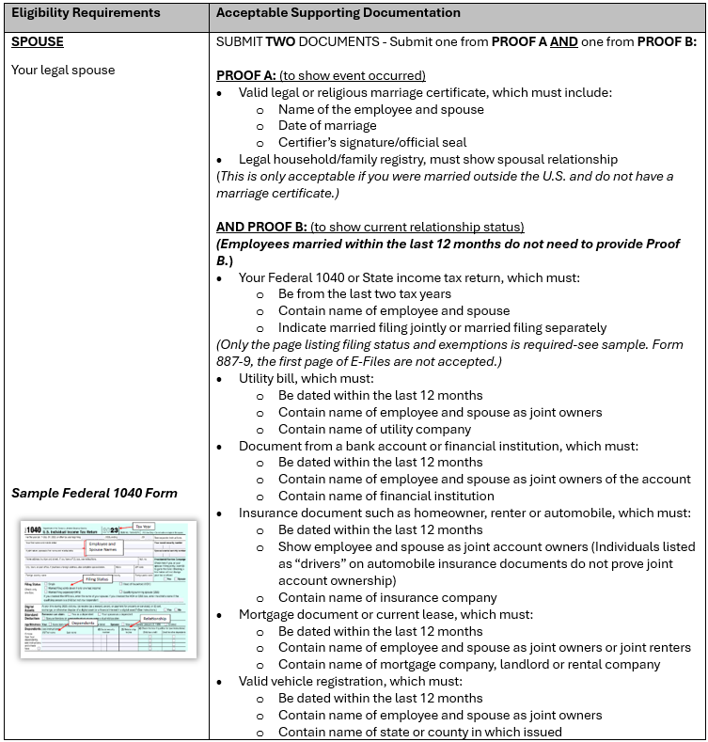
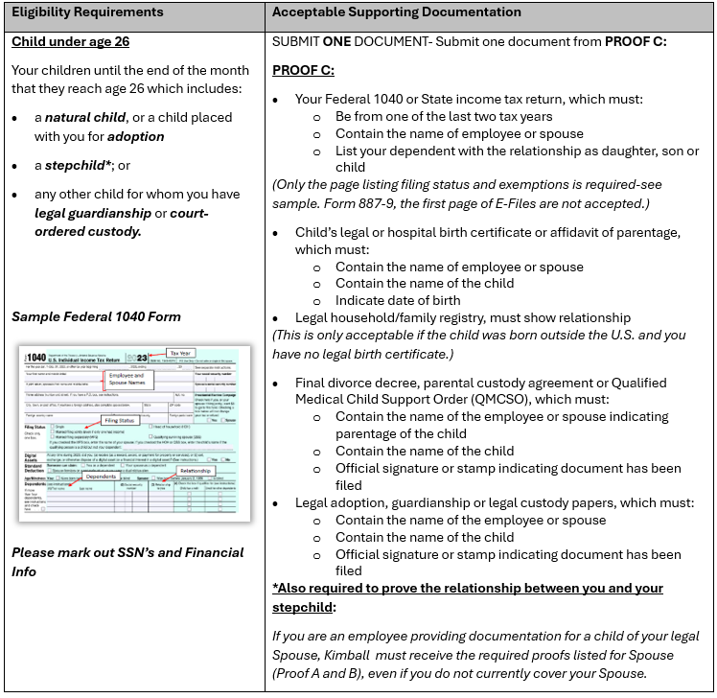
DEV Verification Process
Notes:
If you add coverage to a dependent, you will be asked to provide the necessary documentation to enable us to verify the eligibility. Workday will allow you to attach photos or a scanned document. The process within Workday only allows for one document to be uploaded, you will need to scan all documents as one to upload in Workday. You will be required to upload a document of some sort during the process of making the change to be able to finalize your changes in Workday. If you’re unable to scan and upload your document, you can work through your HR team to provide copies to the Global Benefits Team on your behalf. We do not need the actual document, copies are acceptable.

Slide 6

Our Benefit Plan
Kimball Electronics offers active part time employees the opportunity to select personalized benefit coverage.
(interns/co-ops/temps excluded)
  Health Care & Prescription Drugs
  Health Savings Account (HSA) with qualifying CDHP
  Dependent Care Flexible Savings Account (DCFSA)
  Dental & Vision
  Critical Illness
  Accidental Injury
  Hospital Indemnity
Notes:
Here you see a list of our benefit plan options.
Healthcare and prescription drugs
A health savings account with a qualifying CDHP
A dependent care flexible savings account
Dental and Vison
And the voluntary plans of critical illness, accidental injury and hospital indemnity

Slide 7

Healthcare
Notes:
First let's talk about the medical plan

Slide 8
Healthcare
Options:
    1800 CDHP with HSA Plan
    2700 CDHP with HSA Plan
    750 PPO Plan NOT HSA Eligible
    No Coverage
All Plans include prescription drug coverage through Express Scripts
All plans are self-insured
Notes:
Your options for healthcare coverage are the 1800 CDHP with HSA, the 2700 CDHP with HSA, the750 PPO Plan which is NOT HSA Eligible or no coverage.
All plans have prescription coverage through Express Scripts
All plans are self insured – which means that Kimball Electronics pays the claims each week. Programs for coverage are in place to assist all members to be good consumers of their healthcare.

Slide 9
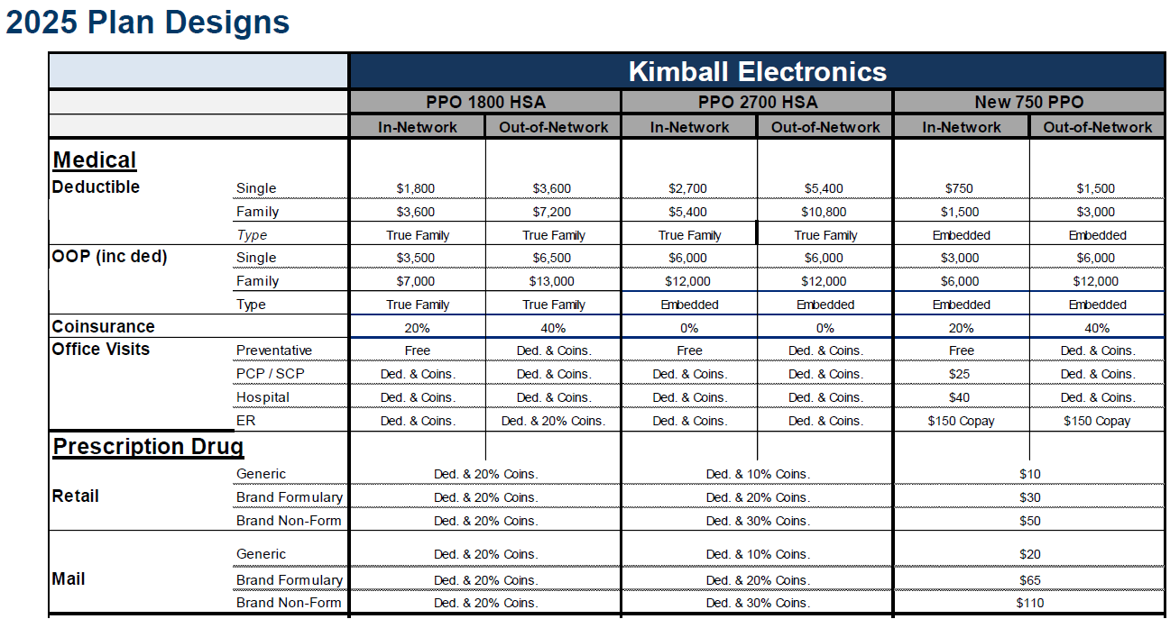
Notes:
See the “at a glance” snapshot of each Plan, In-Network and Out-of-Network Covered Benefits for Single and Family deductibles. Plus, Out of Pocket Limits along with the Coinsurance percentage after the deductible is met, but before Maximum out of pocket limit has been met. A breakdown of Office Visits for preventive care services, Doctor’s Office Visits, Hospital and Emergency Room Care, plus, Prescription Drugs purchases through retail or by Mail.

Slide 10
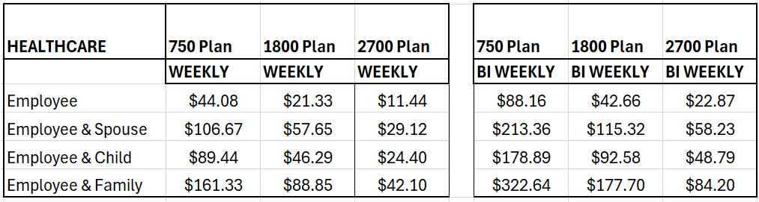
Healthcare Rates
Notes:
On this slide you can see the rates by coverage tier and plan, based on your pay frequency.
Inflation for healthcare is running in the 12% to 18% range over last year. This is driven by an increase in utilization, which is more expenses incurred by our plan, as well, as inflation in the cost of healthcare procedures.

Slide 11
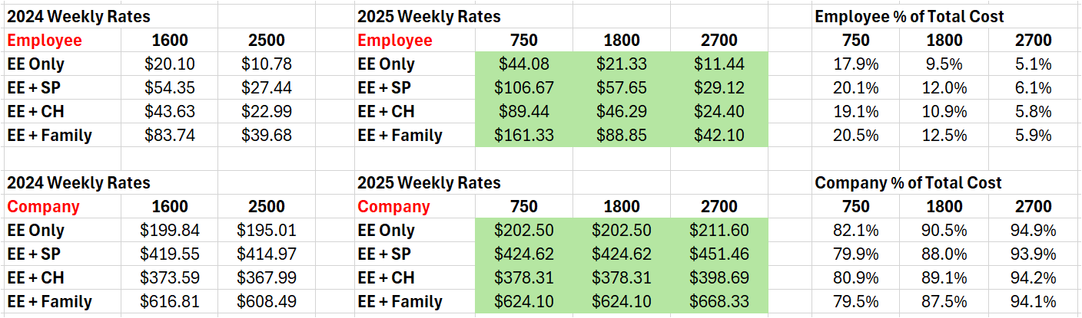
Total Rewards – Healthcare
Notes:
As part of our Total Rewards communication, we want all our new hires to recognize the value of their healthcare benefit provided by the Company.
Here we summarize the WEEKLY cost for you as an employee and the WEEKLY cost for our company for your coverage based on the plan and coverage tier you may elect.
Please take note of the significant amount of cost for being covered in any of our plans that the company covers on your behalf as apart of your Total Rewards at Kimball Electronics. The annual cost for the company varies by coverage tier but runs from $10,530.00 for single coverage up to $34,753.00 for family coverage in the Twenty-Seven Hundred plan. You can see the exact benefit amount based on your election by checking out your Total Rewards page in Workday.

Slide 12
Preventive Care Services
The following services are 100% covered regardless of diagnosis the 1st time they are performed in the calendar year:
  Well-baby, well-child & adult physical exams.
  Immunizations
  Mammography Screening (one additional screening covered if medically required)
  Pap smear & related lab fees with OB/GYN office visit.
  Colorectal screening (colonoscopy, sigmoidoscopy or colorectal exam).
  Prostate specific antigen (PSA) screening.
  Some birth control also covered as preventive
Notes:
From newborn to adulthood, the first physical exam in the calendar year will be covered at 100% if coded as preventive.
Annual exams such as mammograms, pap smears, colorectal screenings and immunizations are also covered if coded as Preventive. Additional screenings, with a medical diagnosis, of any of these are covered but are subject to deductibles and co-insurance.

Slide 13
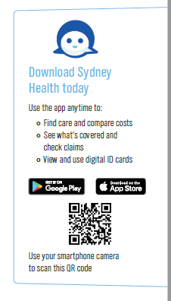

Sydney Health
One digital experience for all your benefits and wellness activities!!
Sydney Preferred delivers a single, trusted digital experience for your entire population
Visibility to all your medical, pharmacy, specialty, and more in one place.
Access for all employees
Challenges to assist in keeping your fitness goals!
Rewards program
Notes:
The Sydney Health app is a one stop shop for ALL employees! If you are enrolled in any of the Kimball Electronics benefits plans, you have visibility to all your medical, pharmacy, dental, vision and voluntary plans in one place.
IN ADDITION, with the Sydney Health app, ALL employees, regardless if you are enrolled in any of the Kimball Electronics benefits plans, have access to the Symptom Checker, health and wellness Challenges and a rewards program, all designed to assist you in your health and wellness journey.
To get started, download the Sydney Health app.

Slide 14
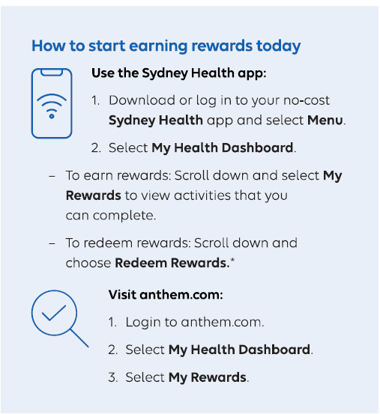
Sydney Health
2025
Peer to Peer CHALLENGES
Get Moving — Who can log the most activity?
Plank Strength —Who can log the most plank minutes building core strength?
Step it up —Who can log the most steps?
Digital Detox —Who can log the most time being disconnected before bedtime?
Eat In – Who can save the most money by eating in?
Money Must Haves – Who can steer clear of making impulse purchases?
Neat & Tidy – Who can be the most organized at work?
Notes:
The Sydney Health app is a place to achieve your wellness goals. With the Sydney Health app, there are individual challenges – small workouts can be very effective, or you may choose to get a team together and compete in one of the Peer to Peer Challenges. Select the challenge that works for you. You can connect your wearable device to Sydney and automatically upload activity to your challenge or you can also enter activity manually.
We are also offering a Rewards Program that employees can earn raffle tickets for daily tracking of your steps, food intake, and sleep. In addition, you can earn raffle tickets for completing your annual preventative exams or just logging into the app each day! You can allocate your earned raffle tickets to different gift card draws each quarter. Just make sure to log into the Sydney app each quarter and make your selections for a chance to win one of 18, $250.00 gift cards. Spouses of employees who are enrolled in the medical plan are also eligible to track and earn raffle tickets for the sweepstakes drawing.

Slide 15

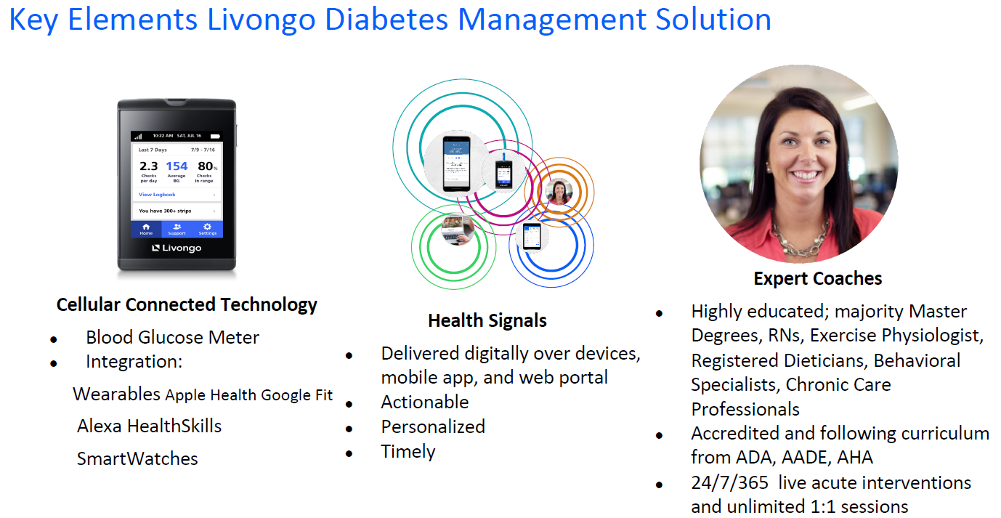
Livongo
Empowering People with Chronic Conditions to Live Better and Healthier Lives – Hypertension Management
Notes:
The Livongo Diabetes and Hypertension Management programs are available to members who have a diagnosis of diabetes and/or hypertension.
If you register to use the Diabetes Management program, you will receive a free Glucose Meter which integrates with most smart devices. The meter electronically transmits your blood sugar numbers to the program management team who can reach out to you in a very timely manner if issues are identified.
Having hypertension puts you at a 3 times higher risk for stroke, heart attack and kidney disease. We want to make it easy for members to better understand their condition. With enrollment in the Hypertension program each participant receives a cellular enabled blood pressure cuff. Data is automatically uploaded to Livongo’s data engine for a personalized experience. You will establish a baseline for your blood pressure readings, and you will have access to a one-on-one coach to establish and initiate activities and goals to consistently monitor your blood pressure
We encourage all members with these conditions to take advantage of these two programs to assist you in managing your diagnosis for improved health and the lowering of your healthcare costs. If you have a diabetes or hypertension healthcare claims, you will receive communications on how to enroll in these programs.

Slide 16
Diabetes Risk but not diagnosed?
    Anthem Blue Cross and Blue Shield continues to provide a benefit called the Diabetes Prevention Program (DPP). The DPP will be available at no cost to all Anthem members 18 and older who qualify.
    Lark is our partner that supplies the DPP through Anthem.
  1 in 3 of us is at risk for diabetes. More than 86 million Americans today have prediabetes, and most of us don’t know it.
  Prediabetes means that blood sugar levels are higher than normal, but not high enough yet to be classified as type 2 diabetes.
Notes:
Anthem Blue Cross and Blue Shield provides a benefit called the Diabetes Prevention Program (DPP). The DPP will be available at no cost to all Anthem members (employees and covered dependents) who are age 18 and older that qualify.
Lark is the partner that supplies the DPP through Anthem.
1 in 3 of us is at risk for diabetes. More than 86 million Americans today have prediabetes, and most don’t know it.
Prediabetes means that blood sugar levels are higher than normal, but not high enough yet to be classified as type 2 diabetes.
Having a family history of diabetes is generally enough to qualify you for this program.
The DPP is a 16-week program designed to help participants adopt healthier lifestyle habits and lose a modest amount of weight
The program focuses on healthier eating, increased physical activity, and managing the challenges that are associated with lifestyle change.
After the initial 16 weeks, participants attend monthly sessions to reinforce the new lifestyle habits they’ve adopted.

Slide 17
Lark
Download the Sydney Health mobile app
Login using your Anthem credentials
On the Lark DPP screen under Programs in My Health Dashboard, take the one minute survey.
  Not for those who have already been diagnosed
  Not for those with low risk factors
This is covered as preventive for each person eligible to participate in the program.
Notes:
To determine if you are eligible for this program, Download the Sydney Health mobile app. Login using your Anthem credentials. Go to the Programs in My Health Dashboard and take the one-minute survey.
Not for those who have already been diagnosed
Not for those with low risk factors
This is covered as preventive for each person eligible to participate in the program.
If you participate online or via your smart phone, you will be provided a “smart scale” and once you meet certain milestones, you will also receive a Fitbit.

Slide 18



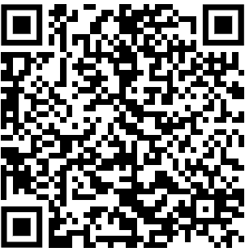

Your covered weight loss and diabetes reversal* benefit
Virta will be your guided nutrition program—available at $0 cost to you.
Personalized to your lifestyle and health goals,
Virta uses nutrition science to build custom
plans that help you lose weight, lower your blood sugar, and transform your health.
Claim your benefit today at www.virtahealth.com/join/anthem
*Reversal on Virta is defined by reaching HbA1c below 6.5% without the use of diabetes medications beyond metformin. Diabetes and related issues can return if lifestyle changes are not maintained.
Notes:
Virta is a guided nutrition program to help you sustainably lose weight, reverse diabetes, and transform your health, which is available at zero cost to you, through our Anthem partnership.
This program is a life changing approach to type 2 diabetes and sustainable weight loss. A different future is possible. One where you reverse your condition, walk further than yesterday, keep up with your grandkids, and get off medications. Whether you live with type 2 diabetes, prediabetes, or want to loss unhealthy weight, we help you on your path to reversal so you can reclaim your future.
If you are a type 2 diabetic or pre-diabetic, you may expect to receive some targeted communications directly from Virta to encourage you to take advantage of this program. It has the capability to be life changing and we hope everyone who is eligible takes advantage of this great program.

Slide 19

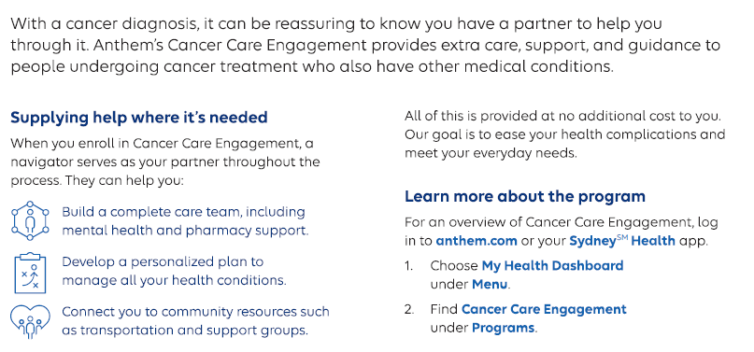
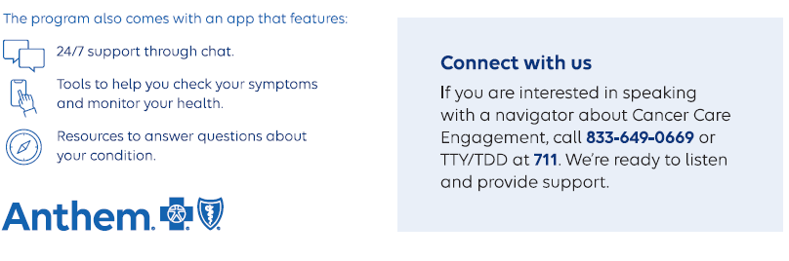
Notes:
Cancer is a prevalent condition within our workforce and providing a service that assists you through the process is another great example of how we show great care for our people. In partnership with Anthem Blue Cross Blue Shield, we implemented the Cancer Care Engagement Program. If you receive or have received a cancer diagnosis, please take advantage of this program to assist you as you navigate your treatment.

Slide 20
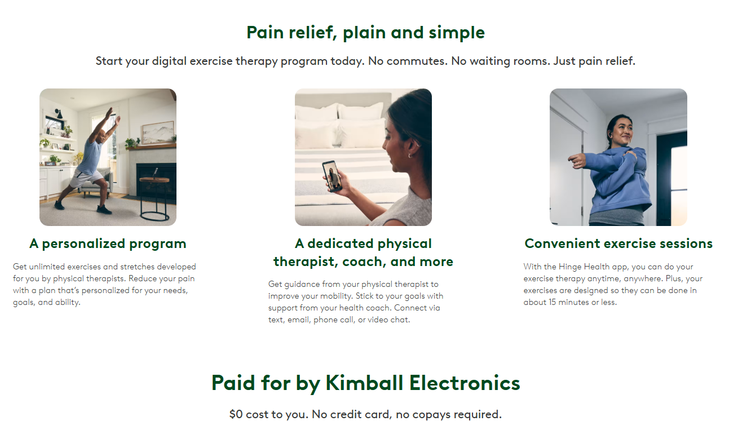
Notes:
Hinge Health’s Digital Clinic for joint and muscle pain. A single solution delivers care for everybody and everybody part at no cost to you.
Prevention (At-Risk) - proactive healthy lifestyle habit formation.
Acute (Recent Injury) - Instant access to a Physical Therapist and customized care plan
Chronic pain and pelvic health - Physical and behavioral support for holistic care.
Surgery (pre and post rehab) – continuity of care before and after surgery

Slide 21


CDHP Prescription Drugs
Each health care plan includes prescription coverage through Express Scripts.
Prescription drugs on preventive drug list don’t apply towards the calendar year deductible but do apply towards out-of-pocket limit and/or are covered at 100% when out-of-pocket limit is met.
Specialty drugs apply toward calendar year deductible & out-of-pocket limit.
Smart90 Program requires certain drugs to be filled in 90 day supply through Accredo or any retail pharmacy.
Notes:
Our plan includes prescription coverage through Express Scripts.
Prescription drugs that aren’t on the preventive drug list are applied towards the annual deductible.
For drugs ON the preventive drug there is a co-pay depending on the drug classification.
The preventive drug list can be accessed through the Sydney Health app or the Anthem Website or via Workday Drive
If you are taking an expensive medication, discuss options with your pharmacist. There may be lower cost medications or financial assistance available.
We have mail order available through Accredo Pharmacy. The Smart 90 program requires that certain maintenance drugs such as for high blood pressure or high cholesterol be filled in 9-day supply for a cost savings.

Slide 22

Health Savings Accounts

Slide 23
HSA Plan Eligibility
The IRS and the U.S. Department of the Treasury have specific rules on who can open an HSA.
Note: You cannot open an HSA if you have coverage under any other health plan that is not an HSA-compatible health plan.
You can open an HSA if you:
  Are enrolled in a qualified CDHP.
  Are a U.S. resident.
  Are not enrolled in Medicare, including Medicare Part A.
  Are not claimed as a dependent on another individual’s
  tax return - other than spouse.
  Not eligible for a spouse's flexible spending account .
  Are not active military.
  If you are not eligible to contribute to the HSA for one of these reasons, please notify your HR department. This is especially important if you select the Premium CDHP Medical Plan Option.
Notes:
The Health Savings account or H S A is savings account that you can contribute pretax dollars, to use to pay qualified medical expenses. The IRS has specific rules on who is eligible to contribute to an HSA. The major requirement is that you can not be covered under another medical plan that isn’t considered an HSA compatible plan. You cannot be enrolled in Medicare Part A or Part B, and you cannot be eligible for a healthcare flex spending account.
If you are not eligible to contribute to the H.S.A. please notify your HR department to sign the HSA Waiver form.
If you have a question about eligibility, ask someone in your HR department and they will get the answer for you.

Slide 24
2025 Health Savings Account (HSA)
1800 and 2700 CDHP
IRS Maximum HSA Contribution Limit Single: $4,300 Family: $8,550
Age 55 and over Additional amount you can deposit is $1,000
A covered medical expense is a benefit covered by our medical plans.
A qualified medical expense is defined by the IRS.
Notes:
The annual contribution limits for 2025 are $4,300 for single coverage and $8,550 for family coverage. Our system is programmed to limit your contributions based on the IRS guidelines.
For those who are over age 55, you can contribute an additional $1,000 per year to your H S A. If you are eligible to contribute the additional $1,000 you will need to contact the Payroll or Benefits team to set this up in Workday.
We encourage you to refer to the IRS website if you have any questions regarding allowable HSA expenses.

Slide 25
Dependent Care Flexible Spending Account
A Dependent Care Flexible Spending Account of DCFSA is a pre-tax benefit account used to pay for dependent care services while you work.
This may include pre-school, summer day camp, before or after school programs, child and adult day care.
Notes:
A Dependent care flexible spending account is to be used to assist employees with the cost of childcare and elder dependent care. A Dependent Care flexible spending account is a pre-tax benefit that you can use to pay for dependent care services. This may include pre-school, summer day camp, before or after school programs, child and adult day care.

Slide 26
Dependent Care Flexible Spending Account
A dependent is a child under age 13 (ends on their 13th birthday) and adult dependents who can’t take care of themselves and who depend on you for more than half of their financial support for the year.
Expenses qualify if the care makes it possible for you or your spouse to work or go to school full time. If your spouse is a stay-at-home parent, you should not enroll in a dependent care FSA.
IRS maximum contribution limit is $5,000 per year per couple. If you and your spouse are eligible for a DCFSA at a separate employer, it is your responsibility to insure no more than $5,000 is jointly contributed.
DCFSA cannot allow for carryover privilege, meaning if you do not use all the money contributed by the end of the year, the money is forfeited. There is a 90-day grace period following the end of the plan year to submit expenses incurred in the previous year.
Notes:
Highlights of a dependent care spending account are:
A dependent is a child up to age 13 or an adult who can not take are of themselves and who depend on you for more than half of their financial support for the year and are listed as a dependent on your federal tax return.
Expenses qualify if the care makes it possible for you to work or go to school full time. If your spouse is a stay-at-home parent, you are not eligible for a dependent care account.
The maximum limit of pretax dollars you can contribute is $5,000 per year per couple. If you and your spouse are eligible to contribute to a dependent care account, it is your responsibility to insure no more than $5,000 is jointly contributed per year.
A dependent care flexible spending account cannot be rolled over year to year. Meaning the money, you contribute for the year must be used to pay for dependent care expenses in that year or that money is forfeited. There is a 90-day grace period following the end of the year that you can submit expenses incurred in the previous year.

Slide 27
Dependent Care Flexible Spending Account
The amount you contribute via payroll deduction cannot be changed during the year unless you experience a change in status or a change in the cost or coverage of services:
    Change in legal marital status
    Change in number of dependents due to birth or adoption or death
    Change in employment status
    Change in cost of coverage charges
You can pay for services with the debit card. If you have an Anthem HS A it will be the same debit card.
You cannot double dip on reimbursements, if you use the DCFSA to pay for dependent care, you cannot claim the dependent care tax credit on your federal tax return.
Notes:
The amount you contribute via payroll deduction cannot be changed during the year unless you experience a change in status or a change in the cost or coverage of services. A change in status could include a change in legal marital status, a change in the number of dependents due to birth or adoption or death, a change in employment status, or there is a change in the cost of your coverage charges.
You can pay for services with the DC debit card, or you can set up online payments through the Anthem spending accounts portal. If you have an Anthem H.S.A , the same debit card will be used for the Dependent Care Savings Account.
You DO NOT have to carry the Kimball Electronics medical plan to enroll in a Dependent Care Flexible Spending Account.
One last tip – you cannot double dip on reimbursements, meaning if you use the Dependent Care spending account to pay for dependent care, you CANNOT claim the dependent care tax credit on your federal tax return.

Slide 28

Telemedicine
Notes:
Telemedicine

Slide 29

Telemedicine
Anthem offers a telemedicine service by the name of Live Health On-line. It’s an alternative to a face-to-face office visit.
A computer with a webcam is required to the use the service.
Each Live Health On-line visit in 2025 will be a fee of $55.00.
You must register in advance of utilizing the service.
You may now do both physical and mental health visits using Live Health Online.
Notes:
Anthem’s telemedicine service is called Live Health Online. For 2025 there is a cost of $55.00 associated with a medical or mental health visit.
You must register either via the internet or the Live Health Online app prior to utilizing the service.
This is an alternative to a face-to-face doctor's office visit for conditions such as sore throat, sinusitis, flu, allergies. Access to a doctor is available 365 days a year, 24 hours a day.

Slide 30

Dental
Notes:
Dental

Slide 31


Delta Dental Premier
Doesn’t require a network dentist, but discounts are available with one. See deltadentalin.com for list of network dentists.
2 Plan options: $1,000 annual max/$1,500 lifetime orthodontia or $2,000 annual max/$2,500 lifetime orthodontia.
2 coverage levels: employee, employee & children.
Orthodontia benefit extends to age 19; $2000 plan covers adult ortho.
Generic ID Card provided by HR.
Two preventive exams covered per year.
Notes:
For dental coverage we have 2 options available, the $1,000 or the $2,000 plan. You have coverage for two preventive exams in a calendar year.
Both carry orthodontia coverage. The lifetime maximum orthodontia coverage is $1,500 for the $1000 plan and $2,500 for the $2000 plan. The $2000 plan covers adult ortho. For the $1000 plan the orthodontia benefit covers a person up to the age of 19.

Slide 32
Dental
Deductible on Class 2 & 3 services of $50 individual / $150 family.
Non duplication of benefits applies if you have secondary insurance coverage.
Reasonable & customary charges apply; you’re responsible for charges above R&C rates at non-network providers.
Notes:
There is a $50.00 deductible for single coverage or a $150.00 family deductible per year that apply if you have Basic Class 2 or 3 services done which include fillings, crowns, root canals and Xray's.
You receive deeper discounts by utilizing network dentists

Slide 33
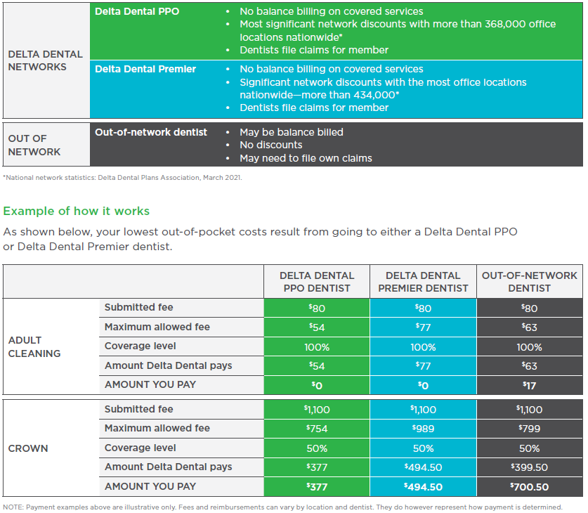
Notes:
With your Delta Dental PPO plan, you may save more money and receive higher levels of coverage when utilizing network dentists. The network dentists have agreed to accept lower fees as full payment for covered services. However, if you go to a dentist who doesn’t participate in Delta Dental PPO, you can still save money if your dentist participates in Delta Dental Premier. See the comparison listed.

Slide 34

Vision
Notes:
Vision

Slide 35

VISION
We offer two Vision plan options
(see page 18 of Benefit Guide for more details).
  Essential (glasses and contacts both covered every 12 months in this plan)
    $10 co pay for eye exam and dilation
    $130 frame allowance
    Standard Plastic Lenses - $20 co pay
    Contact Lens - $130 allowance
  Enhanced (glasses or contacts but not both covered in this plan)
    $0 co pay for eye exam and dilation
    $200 frame allowance
    Standard Plastic Lenses - $10 co pay
    Contact Lens - $160 allowance
Notes:
We have two vision plan options available; the Essential plan and the Enhanced plan. The main difference between the two plans is listed on this slide. One of the main differences is in the frame and contact lens allowance. The Essential Plan allows glasses and contacts both covered every 12 months. The Enhanced plan only allows glasses or contacts but not both, in this plan. You can see more details between the plans by reviewing information on page 18 of the benefit guide.

Slide 36
HIPPA Reminder
To better protect your personal health information and comply with HIPAA privacy rules, any questions regarding Health, Dental and Vision plans must be initially directed to Anthem, Delta Dental, Eye Med. If unable to resolve issue or get questions answered, contact Amy Gilbert or Denise Truelove rather than your HR department.
Questions regarding Short or Long Term Disability, Family Medical Leave, Worker’s Compensation, Retirement Plan or leaves of absence should go through your HR department as they do today.
Notes:
As a reminder, we protect your personal health information and comply with HIPPA privacy rules. If you have any issues with your medical, dental or vision claims, reach out to the appropriate carrier to try to resolve the issue. If you are unable to resolve the issue, feel free to contact Amy Gilbert or Denise Truelove for more assistance. You can contact your local HR dept if you have any questions regarding Short Term Disability or Long-Term Disability, workers comp, leaves of absence or the retirement plan.

Slide 37


Voluntary Benefits:
Accident Insurance, Group Critical Illness & Hospital Indemnity
Notes:
Group Accident, Critical illness and hospital indemnity policies are available through VOYA.

Slide 38
Group Accident
Accident Insurance doesn’t replace your medical coverage; instead, it complements it. The benefit payments don’t go out to pay for medical bills or treatments you may need, instead they come in—directly to you—to be used however you’d like. There are two plans offered the High and the Low Plan. See page 24 of the New Hire Guide for more details.
These benefits can be used for
any purpose, such as:
Benefits are available for, but not limited to:
  Lost time from work
  Mortgage/rent/utilities
  Co-pays/deductibles/coinsurance
  Home healthcare costs
  Childcare expenses
  House-cleaning expenses
  Everyday expenses like groceries
  Surgery
  Hospital admission / confinement
  Emergency Room Treatment
  X-ray
  Lodging / Transportation
  Medical equipment
  Physical or occupational therapy
  Concussion
  Dislocations
  Fractures
Notes:
Cleaning the gutters, Yoga class, Soccer practice. Life offers plenty of opportunities for accidental injuries. When an injury happens, Accident Insurance can help.
Accident Insurance doesn’t replace your medical coverage; instead, it complements it. The benefit payments do not go out to pay for medical bills or treatments you may need, instead they come in – directly to you – to be used however you’d like. Choose this supplemental health insurance product for added protection if some of these treatments are required due to an accident.

Slide 39
Group Accident
Sports Accident Benefit
If your accident occurs while participating in an organized sporting activity as defined in the certificate, the Accident Hospital Care, Accident Care or Common Injuries benefit will be increased by 25%, to a maximum additional benefit of $1000.
If your spouse and/or children are covered for Accident Insurance, their coverage includes this benefit.
Notes:
If your accident occurs while participating in an organized sporting activity, the Group Accident policy benefit will be increased by 25%.
If your spouse or children are covered by the Accident policy, their coverage includes this benefit.

Slide 40
Critical Illness
Critical Illness Insurance pays a lump-sum benefit if you are diagnosed with a covered disease or condition such as cancer, heart attack, stroke on or after your coverage effective date. The three plans offered are $10,000, $20,000 or $30,000.
Quality of Life Benefits
Permanent paralysis
Loss of sight, hearing or speech
Coma
Amyotrophic lateral sclerosis (ALS)
Parkinson’s disease
Advanced dementia, incl. Alzheimer’s
Huntington’s disease
Infectious Disease (incl. covid-19) (25%) – requires 5 day hospitalization
Addison’s disease (10%)
Myasthenia gravis (50%)
Systemic lupus (SLE) (10%)
Systemic sclerosis (10%)
Major Organ Benefits
Severe burns
Transient ischemic attacks (TIA) (10%)
Ruptured or dissecting aneurysm (10%)
Abdominal aortic aneurysm (10%)
Thoracic aortic aneurysm (10%)
Open heart surgery for valve replacement or repair (25%)
Transcatheter heart valve replacement or repair (10%)
Coronary angioplasty (10%)
Implantable cardioverter defibrillator (ICD) placement (25%)
Pacemaker placement (10%)
Base Benefits
Heart attack
Cancer
Stroke
Major organ transplant
Coronary artery bypass (25%)
Carcinoma in situ*(25%)
Enhanced Cancer Benefits
Benign brain tumor
Skin cancer (10%)
Bone marrow transplant
Stem cell transplant (25%)
Notes:
Critical Illness pays a lump sum benefit if you are a diagnosed with a covered disease or condition. The three plans offered are $10,000, $20,000 or $30,000.
You can use this money however you like. For example, you can use it to help pay for expenses not covered by your medical plan, lost wages, childcare, travel, home health care costs or any of your regular household expenses,

Slide 41
Critical Illness
Wellness Benefit
Health screening tests include but are not limited to:
  Blood test for triglycerides
  Bone marrow testing
  Breast ultrasound, sonogram, MRI
  CA 15-3 (breast cancer)
  CEA (blood test for colon cancer)
  Chest x-ray
  Colonoscopy
  Hemoccult stool analysis
  Serum protein electrophoresis (myeloma)
  Fasting blood glucose test
  Mammography
Annual benefit amount is $50
Annual benefit for each child is $25 to a maximum of $100 for all children
Notes:
If you enroll in Critical Illness Insurance coverage, you have access to the Wellness Benefit, which provides a $50.00 yearly benefit if you complete a health screening test, whether or not there were any out-of-pocket costs. The wellness benefit is designed to help you maintain a healthy lifestyle with tests that screen for a wide range of potential illnesses and diseases. If you have family coverage, the wellness benefit is available to all covered members.

Slide 42
Hospital Indemnity
Hospital Indemnity Insurance doesn’t replace your medical coverage; instead, it complements it. Hospital Indemnity pays a daily benefit if you have an eligible confinement in a hospital, critical care unit or rehabilitation facility. The payment is made directly to you to use as you choose:
These benefits can be used for any purpose, such as:
  Lost time from work
  Mortgage/rent/utilities
  Co-pays/deductibles/coinsurance
  Home health care expenses
  Childcare expenses
There are two plans offered the High and the Low Plan – See Page 25 of the New Hire Guide for more details
Notes:
Out of pocket costs from a stay in a hospital or other medical facility can be overwhelming. As expenses add up, Hospital Indemnity insurance can help.
With Hospital Indemnity insurance, you’ll receive a fixed daily benefit if you have a covered stay in a hospital intensive care unit, or rehabilitation facility. Benefit amounts depend on the type of facility and number of days of confinement. Hospital Indemnity insurance does not replace your medical coverage, instead it complements it. The benefit payments go directly to you for use however you need.

Slide 43
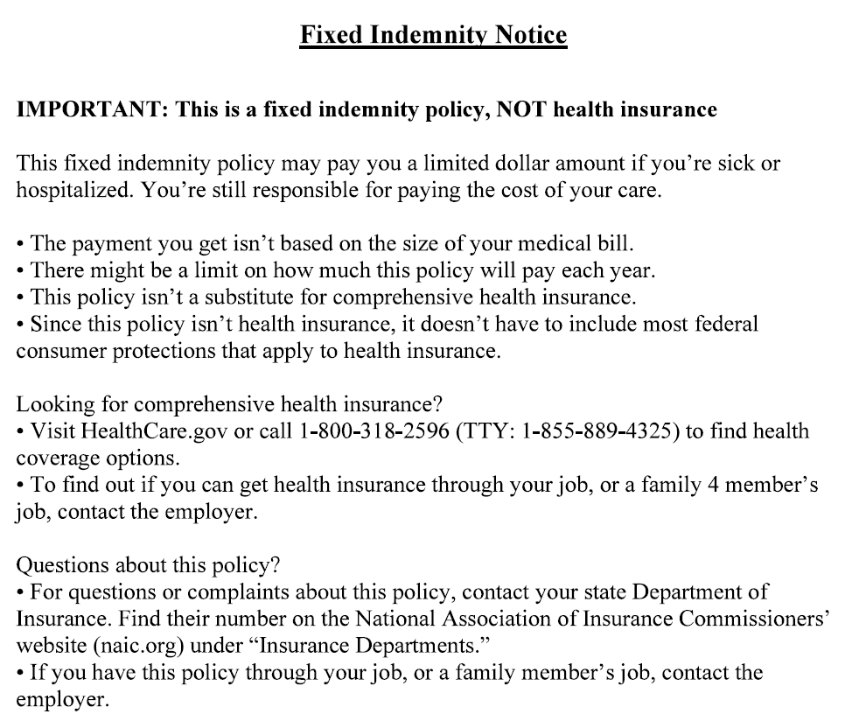
Hospital Indemnity
Notes:
Hospital Indemnity is a fixed indemnity policy, NOT health insurance.
This fixed indemnity policy may pay you a limited dollar amount if you’re sick or hospitalized. You’re still responsible for paying the cost of your care.
The payment you get isn’t based on the size of your medical bill. There might be a limit on how much this policy will pay each year. This policy isn’t a substitute for comprehensive health insurance. Since this policy isn’t health insurance, it doesn’t have to include most federal consumer protections that apply to health insurance. For questions for complaints about this policy, contact your state Department of Insurance.

Slide 44
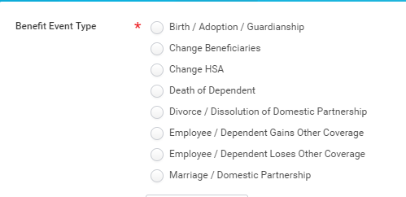
Life Events
Changes to your elections can be made following the enrollment period if you experience a qualifying family status event. You must enter these events in the Workday System within 30 days of the qualifying event.
Events include:
Notes:
Other than during initial new hire enrollment or annual open enrollment period, the only time you can make a change to the benefits that was previously discussed is if a family status event occurs.
Those events include the birth, loss of other coverage by a spouse or child, marriage, divorce or death.
The election you make for 2025 is in effect from January 1, 2025, to December 31, 2025, unless you have a family status event that allows you to make a change. The Dependent Eligibility Verification process will have to be completed.
The family status event must be entered in Workday within 30 days of the event.

Slide 45

Retirement Plan
ENROLL - You will automatically be enrolled in the retirement plan. Approximately 45-60 days after your hire date a 5% deferral will be taken from your pay on a pre-tax basis.
INVEST – your contributions will be invested in the Vanguard Target Retirement Fund with the target date closest to the year in which you will reach age 65.
INCREASE – your contribution rate will increase by 1% each July to help you save more in the future.
EMPLOYER MATCH – Kimball Electronics will match 50% on your pre-tax and Roth contributions up to 6%
ANNUAL EMPLOYER CONTRIBUTION – in addition to the 50% match, Kimball Electronics will make a discretionary contribution annually to your account whether you contribute or not to the plan.
ROLLOVERS – if you have money from a previous employer’s qualified retirement plan or an IRA, you can roll it over to the Kimball Electronics plan.
MANAGE your account – by logging into your account at www.vanguard.com/retirementplans, you can stop or change your payroll deductions, change how your contributions are invested move money between funds or request loans or withdrawals.
Notes:
The Kimball Electronics Retirement Plan is administered through Vanguard. Every Kimball Electronics employee is automatically enrolled in the retirement plan. Kimball Electronics wants all employees to be able to retire comfortably. To assist you in saving for retirement, a 5% pretax deferral will be taken from your paycheck approximately 45 to 60 days after your hire date. Your contributions will be invested in the Vanguard Target Date Retirement Fund with a target date closest to the year in which you will reach age 65. You will also be enrolled in the One Step Program whereby your contribution rate will increase by 1% each July to help you save more in the future.
Kimball Electronics also has an employer match program. Kimball will match 50% of your pre-tax and Roth contributions up to 6% on your weekly or biweekly paycheck. In addition to the 50% match, Kimball will make a discretionary contribution annually to your account whether you contribute or not to the plan.,
If you have money from a previous employer’s qualified retirement plan or an IRA, you can roll it over into the Kimball Electronics plan,
You can manage your account by registering at www.vanguard.com or by calling Participant Services at 1-800-523-1188.

Slide 46

Questions?
Notes:
Do you have any questions that haven’t been answered during this presentation?
If you prefer to ask your question in private, please contact a member of your HR team or feel free to Amy Gilbert or Denise Truelove directly.

